Slide 1
Linear time algorithms for the ring loading problem with demand splitting
Biing-Feng Wang
Journal of Algorithms 54 (2005) 45-57
Presenter: Yung-Hsing Peng
Date: 2005.10.20

Slide 2
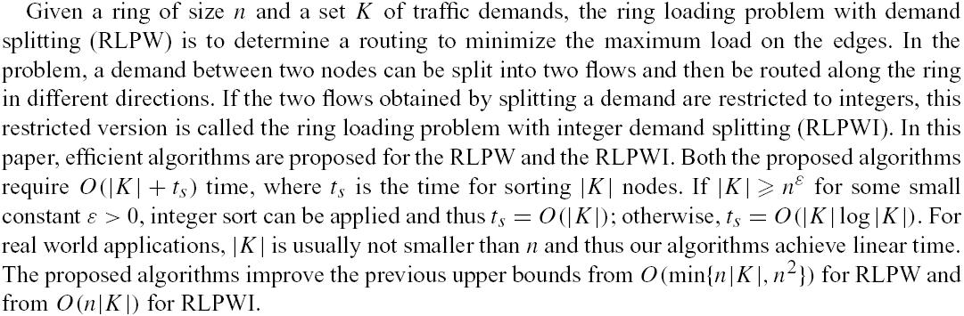
Abstract

Slide 3
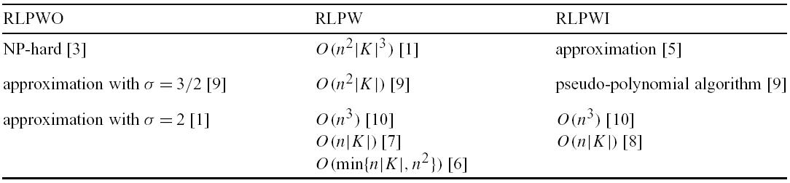
Previous Results
RLPWO: RLP without demand splitting
RLPW: RLP with demand splitting
RLPWI: RLP with integer demand splitting

Slide 4
What’s the problem
Let n = 6, k = {(1,4,3), (1,6,5), (2,5,2), (2,4,4), (3,6,4)}
4
4
2
5
3
1
2
3
4
5
6
1
e₁
e₂
e₃
e₄
e₅
e₆
F_{k}
8
14
18
11
9
0
Heavy load
no load
Goal: Try to minimize max(F_{k}) by turning a fraction of flows from right to left.

Slide 5
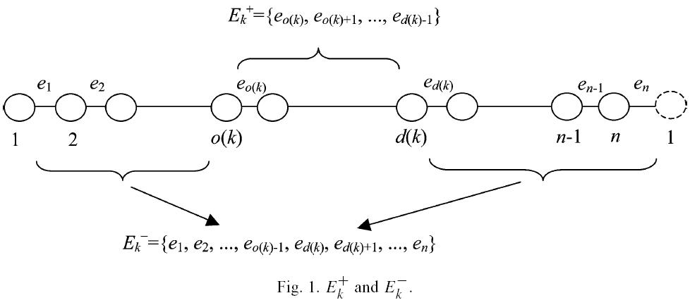
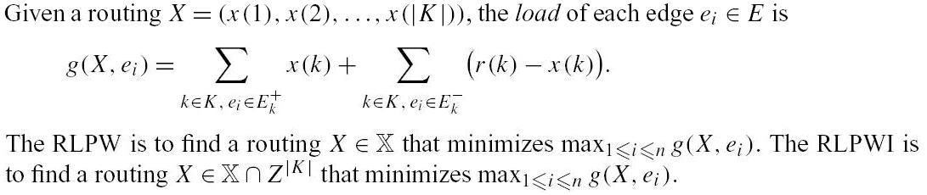
Variables I

Slide 6
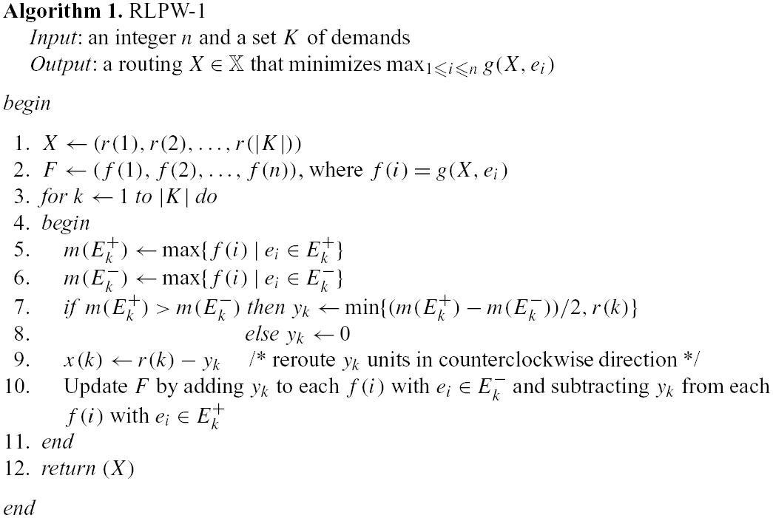
Previous Algorithm
This algorithms runs in O(|k|n) time

Slide 7
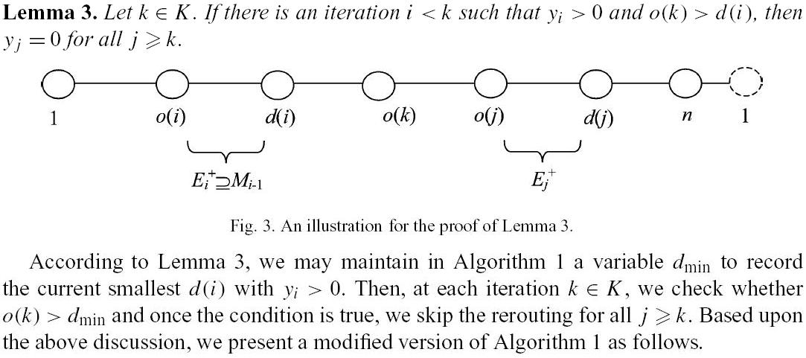
A Breakpoint
Processing
It means that we can stop when the maximum load appears in left side.

Slide 8
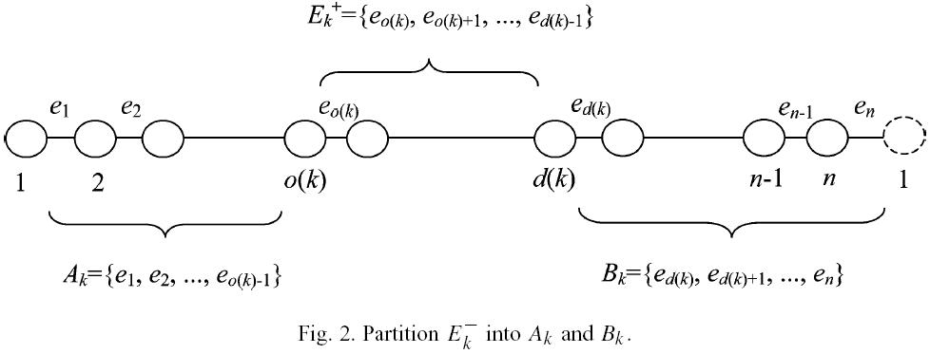
Variables II

Slide 9
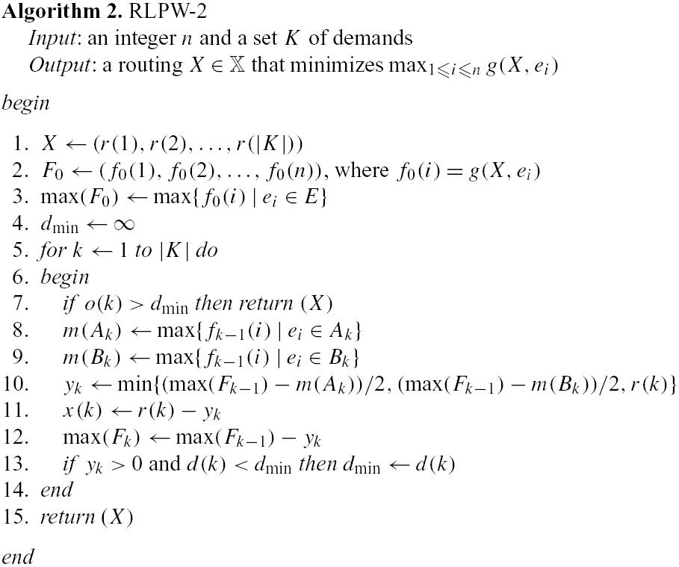
Modified Algorithm
m(E_{k})⁺ is ignored here (why?)
By conquering three bottlenecks (red lines), this algorithms runs in O(n) time.

Slide 10
Finding max(F₀) in O(n)
(1) initialize a sequence (s(1), s(2), …, s(n)) = (0, 0, …, 0).
(2) For each k, do the following assignment
<1> s(1) = r(k) – x(k)
<2> s(o(k)) = – r(k) + 2x(k)
<3> s(d(k)) = r(k) – 2x(k)
By doing so we can compute g(X, ei) as s(1) + s(2) + …+ s(i)

Slide 11
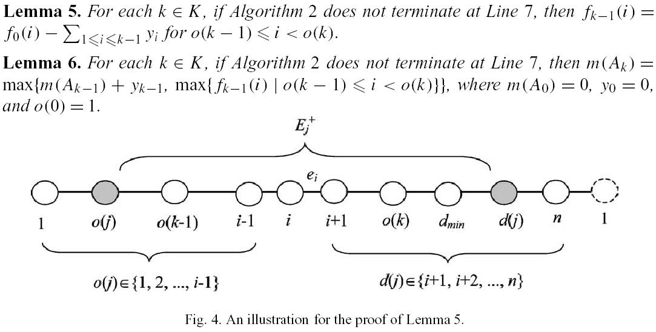
Finding all m(A_{k}) in O(n) (1/2)
Let e_{i} be an edge between k-1 and k, then e_{i} is in E_{j}⁺, for all j ≤ k-1 and y_{j} >0
→ Previously, these e_{i} are all under the same splitting flow (y_{j} > 0 means the maximum appears in E_{j}+, and the above figure is the only case that will not be terminated).

Slide 12
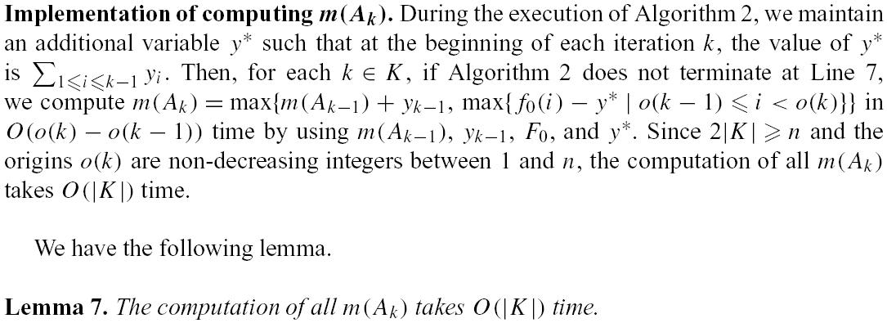
Finding all m(A_{k}) in O(n) (2/2)

Slide 13
Finding all m(B_{k}) in O(n) (1/2)
m(B_{k}) can be found by using suffix maximum + interval union-find datastructure
Load Sequence F
9 | 4 | 3 | 7 | 6 | 1 | 5
Suffix maximum
9 | 7 | 7 | 7 | 6 | 5 | 5
Index sequence Γ(F) = (1, 4, 5, 7) = (γ(1), γ(2), γ(3), γ(4) ) → use link list
π(F,1) = 1, π(F,2~4) = 4, π(F,5) = 5, π(F,6~7) = 7
F(γ(1)) = max(F) = 9, let γ(g) = F(π(F, d(k))) = m(B_{k})
γ(g) can be obtained by FIND(d(k)) since there are intervals in suffix maximum

Slide 14
Finding all m(B_{k}) in O(n) (2/2)
When we are splitting a flow, the suffix maximum and some element in Γ(F) will disappear.
The value of m(B_{k}) may not always be used, hence we can use difference coding to obtain it’s value when it is really needed. (please read the paper for detailed description)
Update the domain intervals by a series of UNION (for FIND(d(k+1))
γ(1)
γ(g)
F
(1)Each update in a single iterations takes O(|Γ(F_{k-1})| - |Γ(F_{k})|) → total cost O(|k|)
(2)There will be |k| FINDs and at most n UNIONs → total cost O(|k| + n) [4]
→ From (1) and (2) we can conquer all m(B_{k}) in linear time.

Slide 15
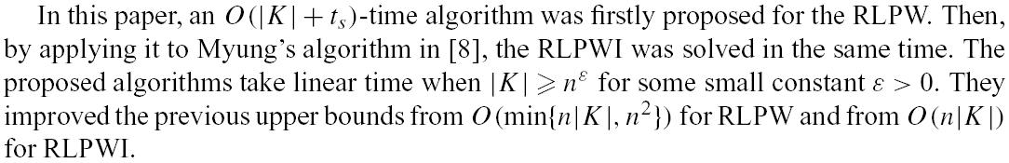
Summary

Slide 16
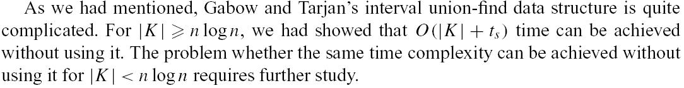
Open Problem (1/2)

Slide 17
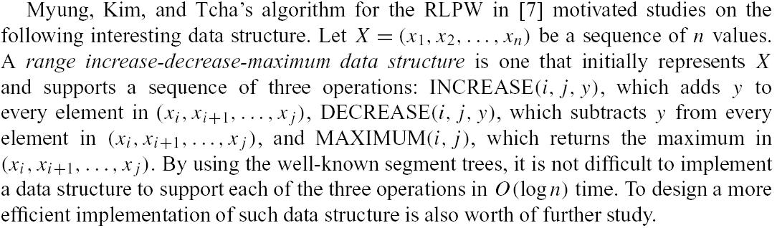
Open Problem (2/2)

Slide 18
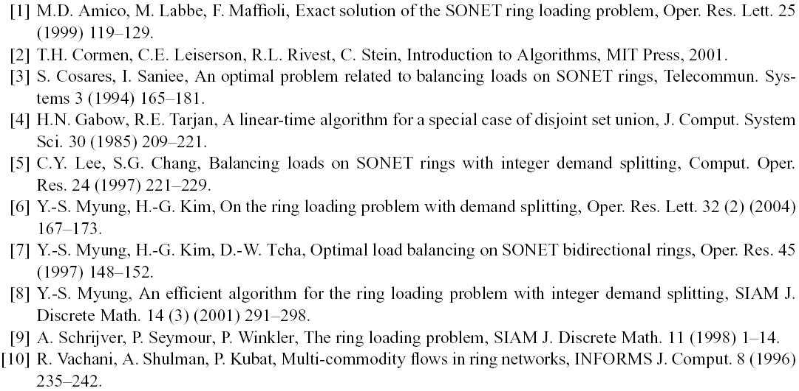
Reference

